Slide 1
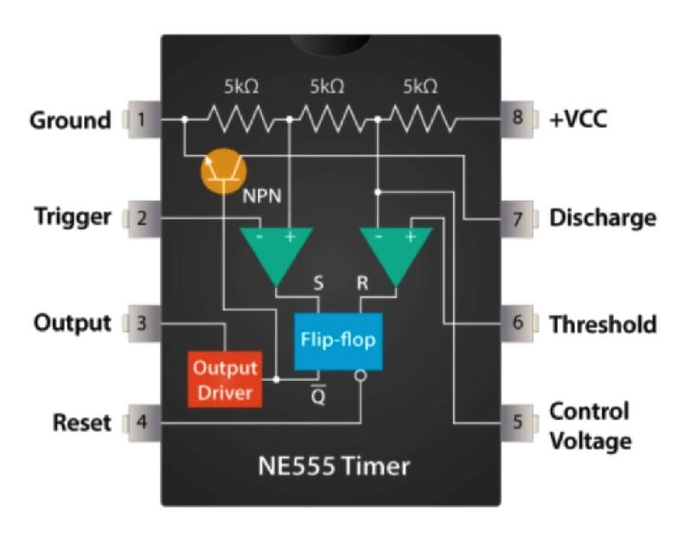
Timer Day (IC555)
Dr. Mitesh Solanki

Slide 2
Introduction
One such device that has been around since the early days of IC’s and has itself become something of an industry “standard” is the 555 Timer Oscillator which is more commonly called the “555 Timer”.
555 Timer Integrated Circuit (IC) is a monolithic timing circuit introduced by Signetic Corporation in 1970 (SE/NE 555 timer).
It is basically a monolithic timing circuit that produces accurate and highly stable time delays or oscillation.
555 timer IC is available as a 8-pin metal or as 14-pin DIP.
Depending on the manufacturing company, the internal structure of the IC has around 23 transistors, 2 diodes and 16 resistors.

Slide 3
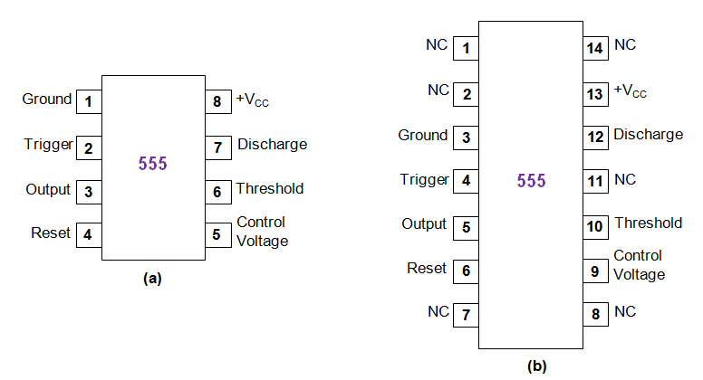
The pin configuration of 555 Timer IC

Slide 4
The important features of the 555 timer are :
It operates from a wide range of power supplies ranging from + 5 Volts to + 18 Volts supply voltage.
Sinking or sourcing 200 mA of load current.
The external components should be selected properly so that the timing intervals can be made into several minutes along with the frequencies exceeding several hundred kilohertz.
The output of a 555 timer can drive a transistor-transistor logic (TTL) due to its high current output.
It has a temperature stability of 50 parts per million (ppm) per degree Celsius change in temperature, or equivalently 0.005 %/ °C.
The duty cycle of the timer is adjustable.
The maximum power dissipation per package is 600 mW and its trigger and reset inputs has logic compatibility. More features are listed in the datasheet.

Slide 5
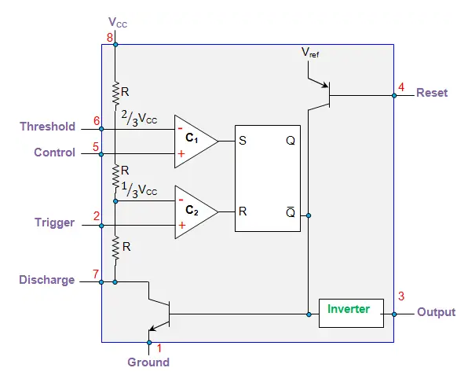
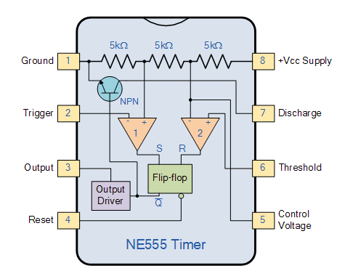
Internal structure of 555 Timer IC
The working of this IC can be understood by analyzing its internal structure which is shown in terms of block diagram (for 8-pin DIP) in Figure 2.
From this, the IC is seen to be composed of
A resistive network formed by three equal resistors (R)
Two Comparators
Two Transistors
One SR flip-flop
An Inverter
https://www.youtube.com/watch?v=ABWU7FlM1T0

Slide 6
A resistive network formed by three equal resistors (R): It is due to these three 5 KΩ resistors, the IC bears its name as 555 timer. These are arranged in voltage divider configuration and as a result provide the voltage values of 2⁄3 VCC and 1⁄3 VCC along their chain.
Two Comparators: These two devices are meant to compare the user-provided input values with their reference levels and accordingly trigger the output of the flip-flop.
Two Transistors: These are associated with discharge and reset operations of the device.
One SR flip-flop: This flip-flop will be either set or reset depending on the output from the comparators.
An Inverter: Inverter is used to obtain the output from the device by complementing the flip-flop’s Q̅ output.

Slide 7
555 Timer IC Pin Configuration
Pin 1: Grounded Terminal: All the voltages are measured with respect to the Ground terminal.
Pin 2: Trigger Terminal: The negative input to comparator No 1. A negative pulse on this pin “sets” the internal Flip-flop when the voltage drops below 1/3Vcc causing the output to switch from a “LOW” to a “HIGH” state.

Slide 8
Pin 3: Output Terminal: he output pin can drive any TTL circuit and is capable of sourcing or sinking up to 200mA of current at an output voltage equal to approximately Vcc – 1.5V so small speakers, LEDs or motors can be connected directly to the output.
Pin 4: Reset Terminal: This pin is used to “reset” the internal Flip-flop controlling the state of the output, pin 3. This is an active-low input and is generally connected to a logic “1” level when not used to prevent any unwanted resetting of the output.

Slide 9
Pin 5: Control Voltage Terminal: This pin controls the timing of the 555 by overriding the 2/3Vcc level of the voltage divider network. By applying a voltage to this pin the width of the output signal can be varied independently of the RC timing network. When not used it is connected to ground via a 10nF capacitor to eliminate any noise.
Pin 6: Threshold Terminal: The positive input to comparator No 2. This pin is used to reset the Flip-flop when the voltage applied to it exceeds 2/3Vcc causing the output to switch from “HIGH” to “LOW” state. This pin connects directly to the RC timing circuit.

Slide 10
Pin 7 : Discharge Terminal: The discharge pin is connected directly to the Collector of an internal NPN transistor which is used to “discharge” the timing capacitor to ground when the output at pin 3 switches “LOW”.
Pin 8: Supply Terminal: This is the power supply pin and for general purpose TTL 555 timers is between 4.5V and 15V.

Slide 11
Working Principle
The internal resistors act as a voltage divider network, providing (2/3)Vcc at the non-inverting terminal of the upper comparator and (1/3)Vcc at the inverting terminal of the lower comparator.
In most applications, the control input is not used, so that the control voltage equals +(2/3) V_{CC}.
Upper comparator has a threshold input (pin 6) and a control input (pin 5).
Output of the upper comparator is applied to set (S) input of the flip-flop.
Whenever the threshold voltage exceeds the control voltage, the upper comparator will set the flip-flop and its output is high.
A high output from the flip-flop when given to the base of the discharge transistor saturates it and thus discharges the transistor that is connected externally to the discharge pin 7.

Slide 12
The complementary signal out of the flip-flop goes to pin 3, the output. The output available at pin 3 is low.
These conditions will prevail until lower comparator triggers the flip-flop.
Even if the voltage at the threshold input falls below (2/3) V_{CC}, that is upper comparator cannot cause the flip-flop to change again.
It means that the upper comparator can only force the flip-flop’s output high.
To change the output of flip-flop to low, the voltage at the trigger input must fall below + (1/3) Vcc.
When this occurs, lower comparator triggers the flip-flop, forcing its output low.
The low output from the flip-flop turns the discharge transistor off and forces the power amplifier to output a high.
These conditions will continue independent of the voltage on the trigger input. Lower comparator can only cause the flip-flop to output low.

Slide 13
Application
These ICs are most extensively used in electronic industry as they are versatile, compact, cheap and highly reliable.
Further, these devices are seen to be used for a wide variety of applications wherein they act as oscillators (astable or monostable or bistable), one-shot or delay timers, pulse generators, LED or lamp flashers, alarm or tone generators, frequency dividers, logic clocks, power suppliers, DC-DC converters, digital logic probes, analog frequency meters, tachometers, temperature measuring devices, control devices, voltage regulators, etc.

Slide 14
Operating Modes
The 555 Timer IC can be connected either in its Monostable mode thereby producing a precision timer of a fixed time duration, or in its Bistable mode to produce a flip-flop type switching action. But we can also connect the 555 timer IC in an Astable mode to produce a very stable 555 Oscillator circuit for generating highly accurate free running waveforms whose output frequency can be adjusted by means of an externally connected RC tank circuit consisting of just two resistors and a capacitor.
The 555 Oscillator is another type of relaxation oscillator for generating stabilized square wave output waveforms of either a fixed frequency of up to 500kHz or of varying duty cycles from 50 to 100%.

Slide 15
Astable Mode
In order to get the 555 Oscillator to operate as an astable multivibrator it is necessary to continuously re-trigger the 555 IC after each and every timing cycle.
This re-triggering is basically achieved by connecting the trigger input (pin 2) and the threshold input (pin 6) together, thereby allowing the device to act as an astable oscillator.
Then the 555 Oscillator has no stable states as it continuously switches from one state to the other.
Also the single timing resistor has been split into two separate resistors, R1 and R2 with their junction connected to the discharge input (pin 7) as shown below.

Slide 16
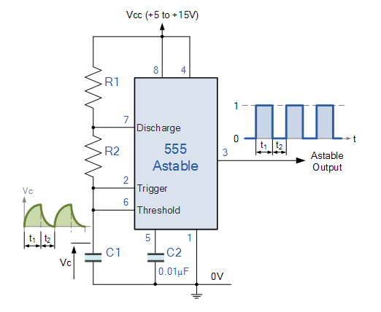
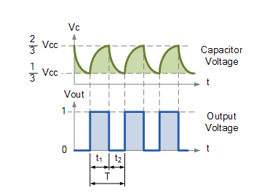
Basic Astable 555 Oscillator Circuit

Slide 17
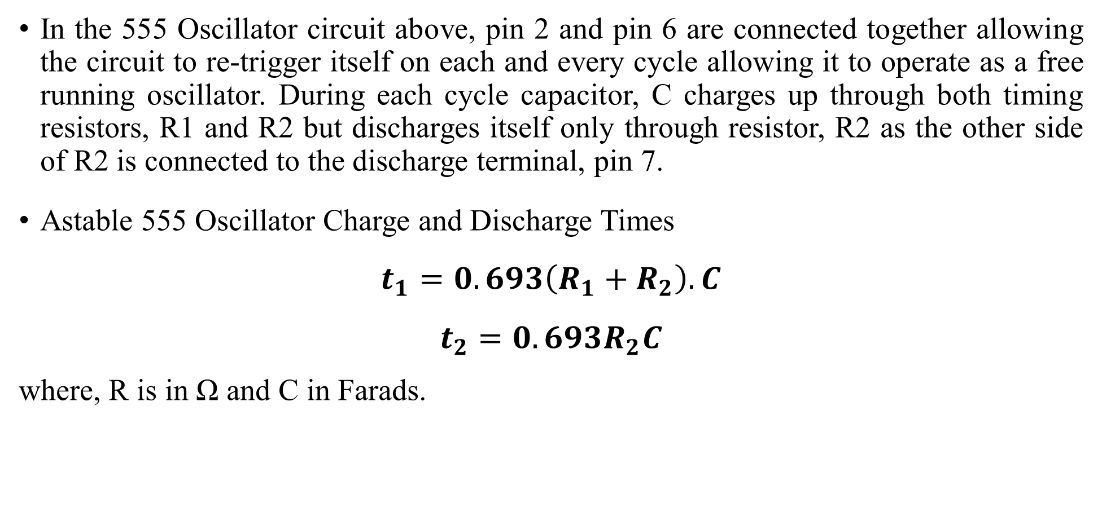
In the 555 Oscillator circuit above, pin 2 and pin 6 are connected together allowing the circuit to re-trigger itself on each and every cycle allowing it to operate as a free running oscillator. During each cycle capacitor, C charges up through both timing resistors, R1 and R2 but discharges itself only through resistor, R2 as the other side of R2 is connected to the discharge terminal, pin 7.
Astable 555 Oscillator Charge and Discharge Times
$$t_{1}=0.693\left(R_{1}+R_{2}\right).C$$
$$t_{2}=0.693R_{2}C$$
where, R is in Ω and C in Farads.

Slide 18
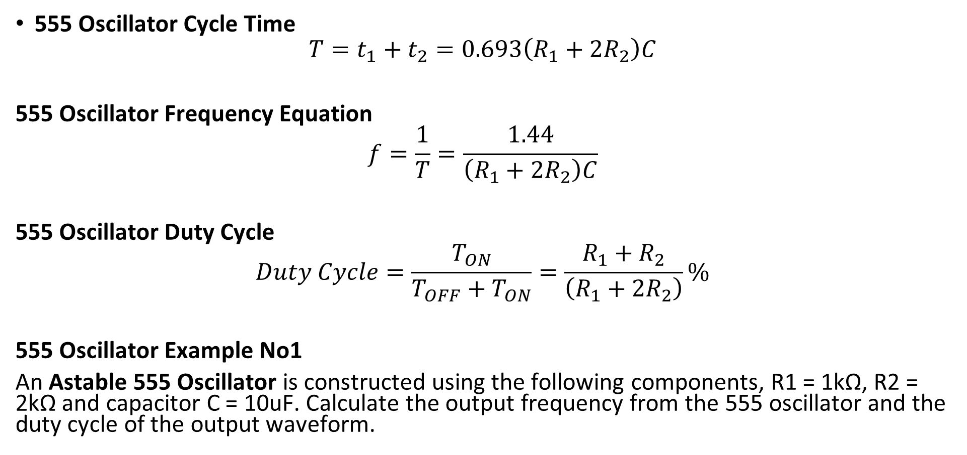
555 Oscillator Cycle Time
$$T=t_{1}+t_{2}=0.693\left(R_{1}+2R_{2}\right)C$$
555 Oscillator Frequency Equation
$$f=\frac{1}{T}=\frac{1.44}{\left(R_{1}+2R_{2}\right)C}$$
555 Oscillator Duty Cycle
$$Duty Cycle=\frac{T_{ON}}{T_{OFF}+T_{ON}}=\frac{R_{1}+R_{2}}{\left(R_{1}+2R_{2}\right)}\%$$
555 Oscillator Example No1
An Astable 555 Oscillator is constructed using the following components, R1 = 1kΩ, R2 = 2kΩ and capacitor C = 10uF. Calculate the output frequency from the 555 oscillator and the duty cycle of the output waveform.

Slide 19
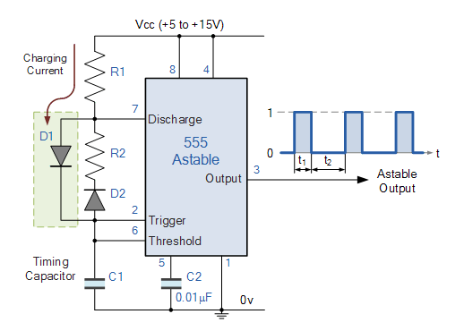
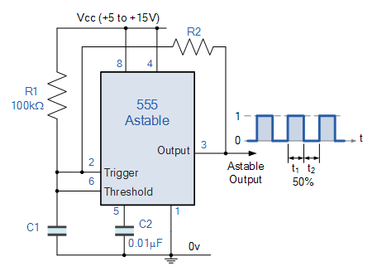
Improved 555 Oscillator Duty Cycle
50% Duty Cycle Frequency Equation
60% Duty Cycle Astable Oscillator

Slide 20
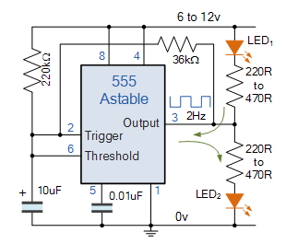

50% Duty Cycle Frequency Equation
$$f=\frac{1}{0.693\left(2R_{2}\right)C}Hz$$
555 Oscillator Applications

Slide 21
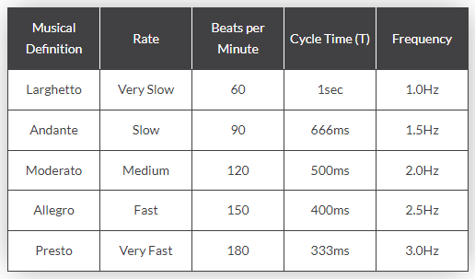
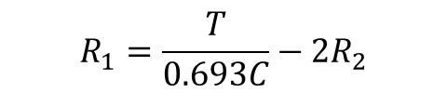
Metronome Frequency Table
The output frequency range of the metronome was simply calculated as the reciprocal of 1 minute or 60 seconds divided by the number of beats per minute required, for example (1/(60 secs / 90 bpm) = 1.5Hz) and 120bpm is equivalent to 2Hz, and so on. So by using our now familiar equation above for calculating the output frequency of an astable 555 oscillator circuit the individual values of R1, R2 and C can be found.
$$R_{1}=\frac{T}{0.693C}−2R_{2}$$

Slide 22
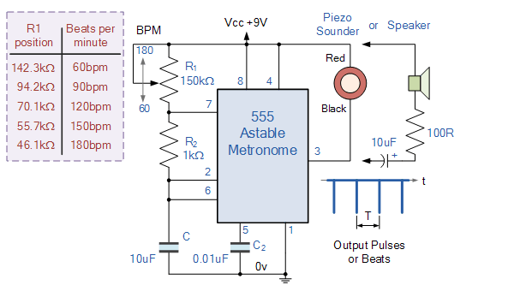
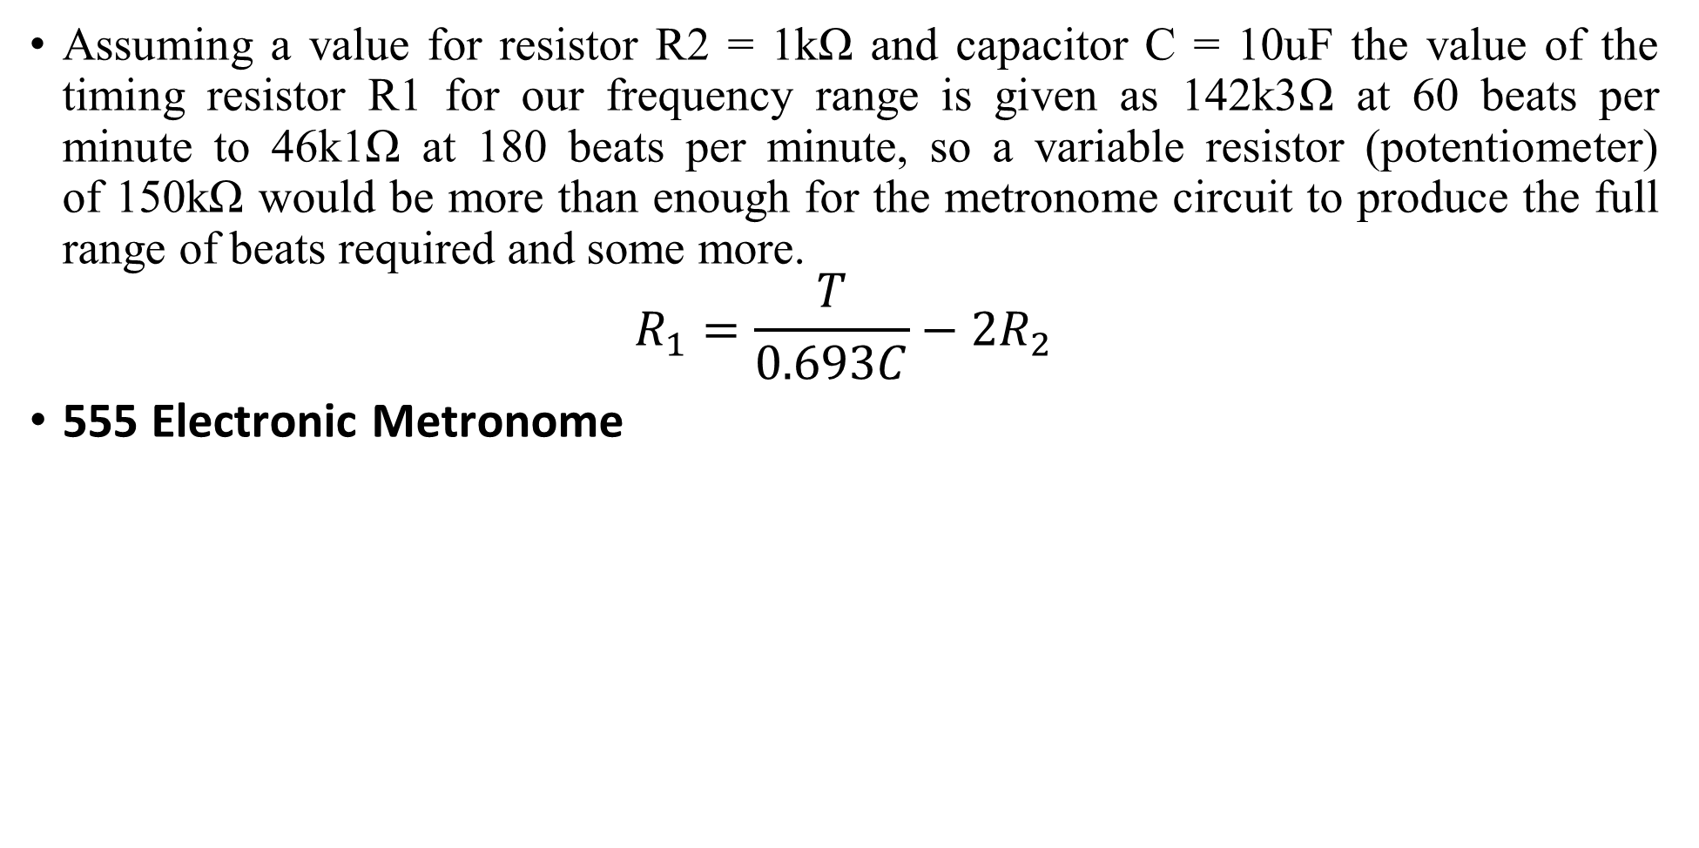
Assuming a value for resistor R2 = 1kΩ and capacitor C = 10uF the value of the timing resistor R1 for our frequency range is given as 142k3Ω at 60 beats per minute to 46k1Ω at 180 beats per minute, so a variable resistor (potentiometer) of 150kΩ would be more than enough for the metronome circuit to produce the full range of beats required and some more.
$$R_{1}=\frac{T}{0.693C}−2R_{2}$$
555 Electronic Metronome

Slide 23
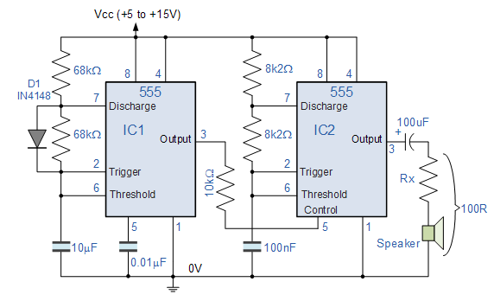
555 Oscillator Police “Dee-Dah” Siren

Slide 24
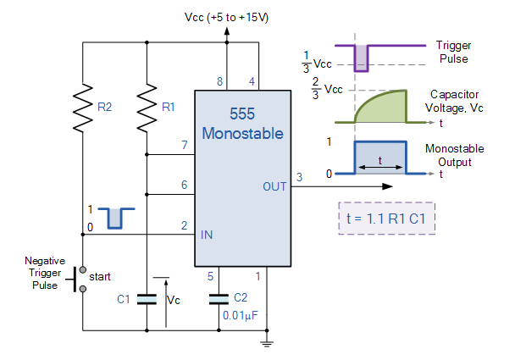
The Monostable 555 Timer

Slide 25
Working
When a negative ( 0V ) pulse is applied to the trigger input (pin 2) of the Monostable configured 555 Timer oscillator, the internal comparator, (comparator No1) detects this input and “sets” the state of the flip-flop, changing the output from a “LOW” state to a “HIGH” state. This action in turn turns “OFF” the discharge transistor connected to pin 7, thereby removing the short circuit across the external timing capacitor, C1.
This action allows the timing capacitor to start to charge up through resistor, R1 until the voltage across the capacitor reaches the threshold (pin 6) voltage of 2/3Vcc set up by the internal voltage divider network. At this point the comparators output goes “HIGH” and “resets” the flip-flop back to its original state which in turn turns “ON” the transistor and discharges the capacitor to ground through pin 7. This causes the output to change its state back to the original stable “LOW” value awaiting another trigger pulse to start the timing process over again. Then as before, the Monostable Multivibrator has only “ONE” stable state.

Slide 26

Example
A Monostable 555 Timer is required to produce a time delay within a circuit. If a 10uF timing capacitor is used, calculate the value of the resistor required to produce a minimum output time delay of 500ms.
$$R=\frac{t}{1.1C}$$

Slide 27
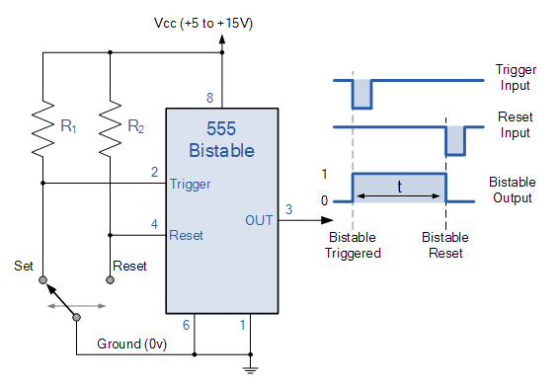
Bistable 555 Timer
The 555 Bistable is one of the simplest circuits we can build using the 555 timer oscillator chip.
This bistable configuration does not use any RC timing network to produce an output waveform so no equations are required to calculate the time period of the circuit.

Slide 28
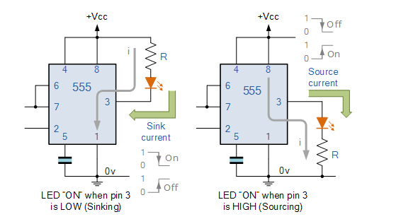
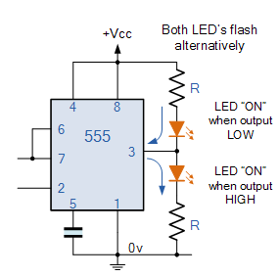
Sinking and Sourcing the 555 Timer Output

Slide 29
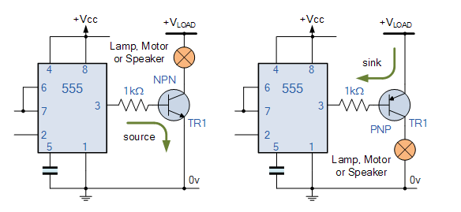
555 Timer Transistor Driver

Slide 30
References:
https://www.electronics-tutorials.ws/waveforms/555_oscillator.html
https://www.electronics-tutorials.ws/waveforms/555_timer.html

